Slide 1

Wheatstone bridge
coffeemaker
Jan Bollen

Slide 2

Agenda
Wheatstone bridge
Opamp Component
Opamp Comparator
Hysteresis

Slide 3
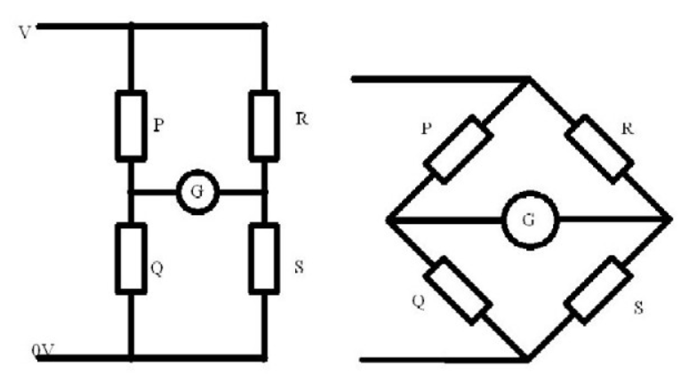
Principle
A Wheatstone
Bridge consists
of two voltage-
dividers.
At balance there is no current that flows through a Galvanometer G ( G = a sensitive ampere meter).

Slide 4
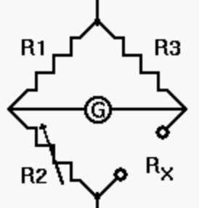
Working
Resistor R_{X} is connected as the fourth side of the circuit
R2 is adjusted until the galvanometer G reads zero.
At this point,
R_{X}/R2 = R3/R1
or
R_{X} = R2×R3/R1.

Slide 5
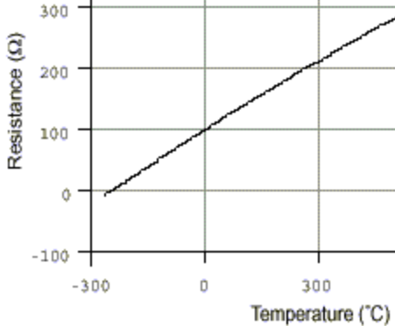
PT-100
Platinum resistance
temperature detector
Pt-100
typical resistance
of 100 Ω at 0°C
Resistance increases lineair
when temperature is increasing

Slide 6
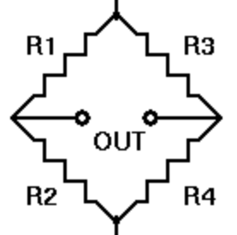
Sensitivity
R2 = PT-100 = 100 Ohm
R1 = R3 = R4 = Rx
Simulate with
Rx = 1 Ohm, Rx = 10 Ohm
Rx = 100 Ohm, Rx = 1k Ohm
Rx = 10 K Ohm
Find the resistor Rx for maximum sensitivity in Uout signal, conclusion?

Slide 7
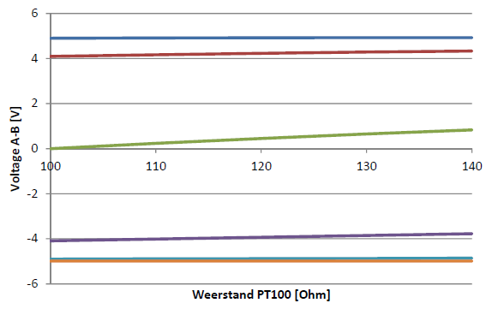
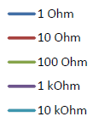
Simulation graph
Bridge Voltage = f (resistance PT-100)

Slide 8
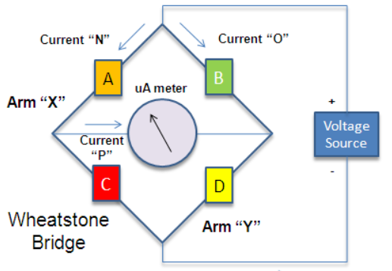
Balance idea for coffeemaker
2 arms;
One for Reference
One for Measuring
In balance A.D = B.C

Slide 9
Opamp Component
coffeemaker
Jan Bollen

Slide 10
OPerational AMPlifier
OPAMP as Comparator
How does an OpAmp work open loop?
What is compare?
What is hysteresis?

Slide 11
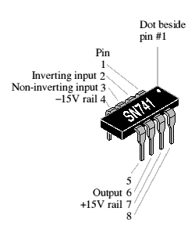
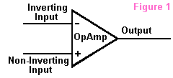
OPAMP, symbol and package

Slide 12
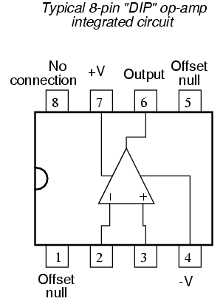
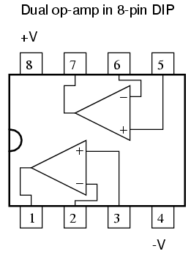
OPAMP, connections
+V = Vcc
= most positive
power supply
-V = Vee
= most negative
power supply
V+ = non-inverting input
V- = inverting input
Output = output

Slide 13
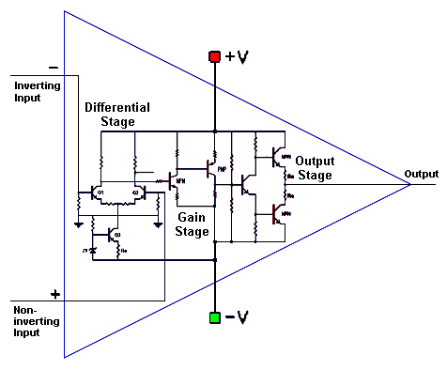
OPAMP, internal
+V = Vcc
-V = Vee
V+ =
non-inverting input
V- =
inverting input
Output = output

Slide 14
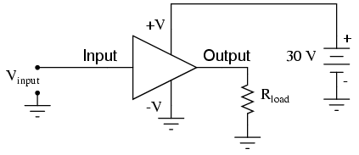
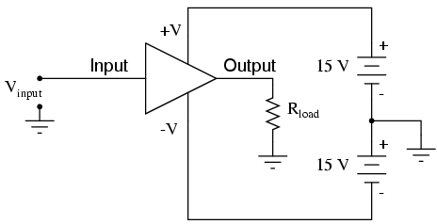
Power connections

Slide 15
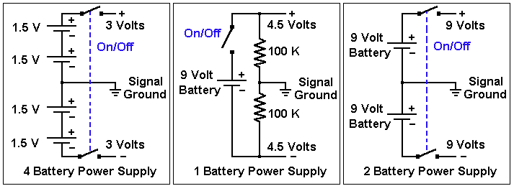
OPAMP, Vcc and Vee, examples

Slide 16
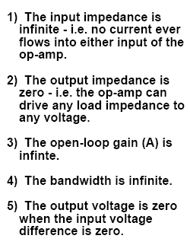
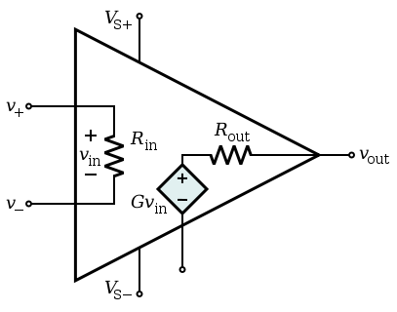
OPAMP, remember
GOLDEN RULES

Slide 17
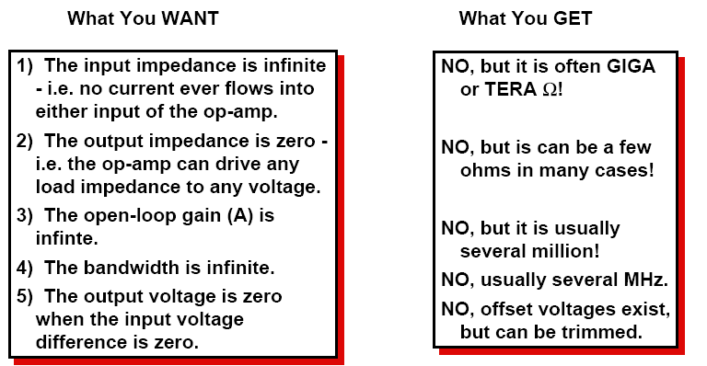
OPAMP, in real

Slide 18
Opamp Comparator
coffeemaker
Jan Bollen

Slide 19
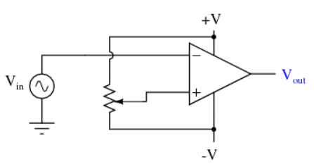
Comparator
+V = Vcc = + 5 Volt
-V = Vee = - 5 Volt
R = voltage divider adjusted at + 1 Volt
V+ = + 1 Volt
V- = sine wave of + 5 Volt top
sine wave of 10 Volt top-top
Question; what will be the output voltage?

Slide 20
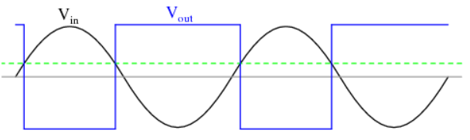
Comparator
Uout = A (V+ - V-)
A = open-loop gain = ∞
Question; what will be the signals if we change the connections of V+ and V-

Slide 21
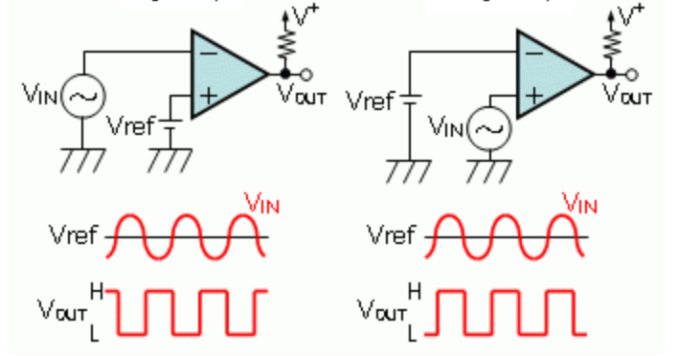
What is the difference?

Slide 22
Case
+V = +15 Volt
-V = -15 Volt
Question;
1 Is this an inverting comparator or
an non-inverting comparator?
2 Can the output voltage be equal to 0 (zero) volt?
3 Conclusion?

Slide 23
Summary
A comparator compares 2 values, in our case
1 a reference value
(desired temperature / set point)
2 a measured value
(actual temperature)
And gives a logical output signal, indicating
too hot (no heating, heating off) or
too low (heating on)

Slide 24
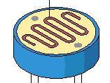
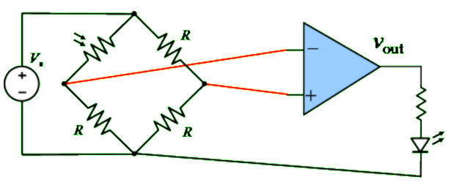
Light switch, example
Explain how this circuit works.
If it is light is the value of LDR high or low
If it is dark is the value of LDR high or low

Slide 25
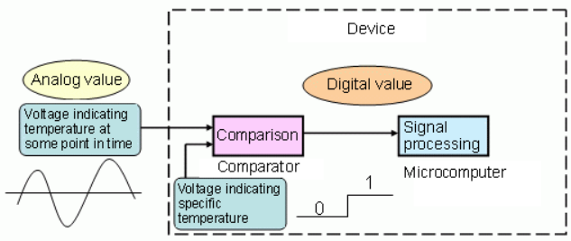
Block diagram

Slide 26
Opamp Hysteresis
coffeemaker
Jan Bollen

Slide 27
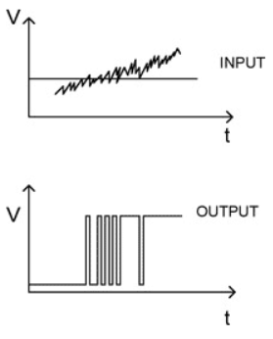
On-Off-On-Off
If temperature changes slightly around set point the heater will be
on-off-on-off-on-off-on-off
This is unwanted,
then we use a hysteresis.

Slide 28
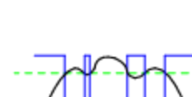
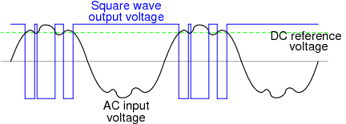
On-Off-On-Off

Slide 29
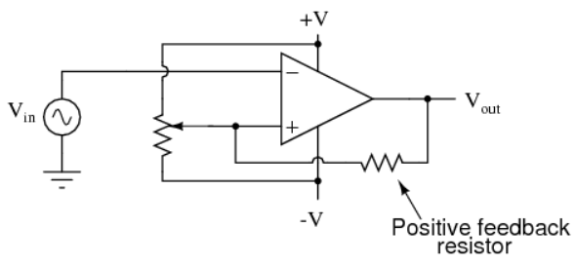
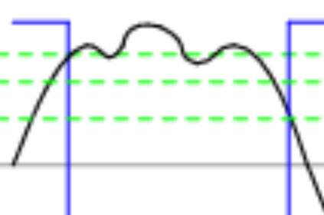
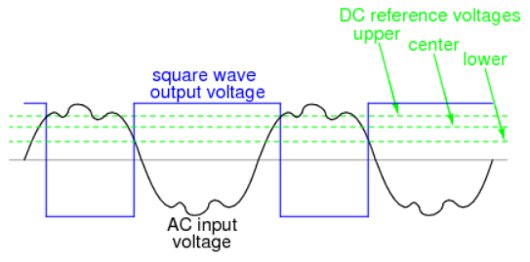
Hysteresis
Changing reference level !!

Slide 30
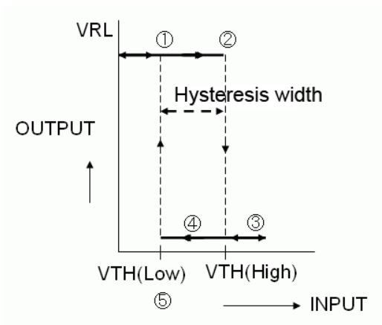
Hysteresis
By using hysteresis we get
2 new threshold voltages
V TH high
V TH low
In between is the
Hysteresis width
or dead zone,
Noise is permitted here

Slide 31
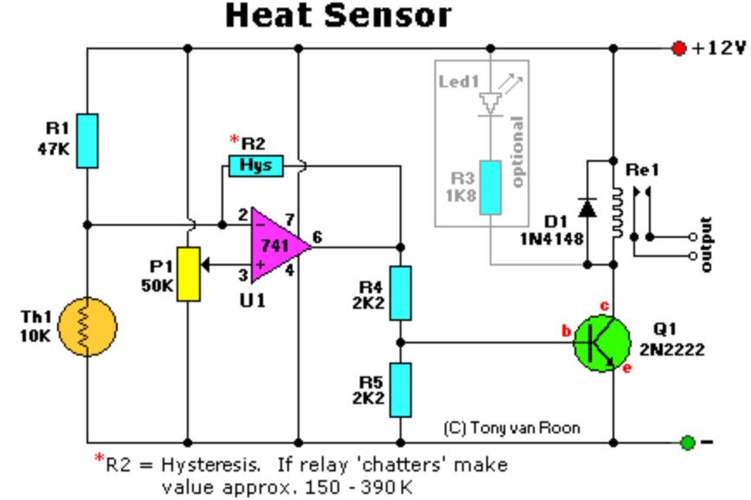

Slide 32




The Thermistor NTC (Negative Temperature Coefficient) is 10K. The resistance lowers as the surrounding temperature increases which affects the output (pin 6) and energizes the small relay and Led1.
P1 is a regular trimmer potentiometer and adjusts a certain range of temperatures.
R2 is optional in case your relays tends to 'chatter' a bit. It provides hysteresis when the set temperature of the thermistor reaches its threshold point.

